Slide 1
From Last Weeks Meeting
6/1/22
Develop two new models
Biased model with cylindric pieces not using flex tool
Fin design without fins
Rebuild 3 chamber to proper spec
Simulate the four models (two above, 3 and 4 chamber designs)
Run same simulations on all models to draw comparisons
Follow up with Ally about print request Friday early or Thursday late
Check in with Kyle about simulations on his models to check validity
More iterations of the Helix (square)

Slide 2
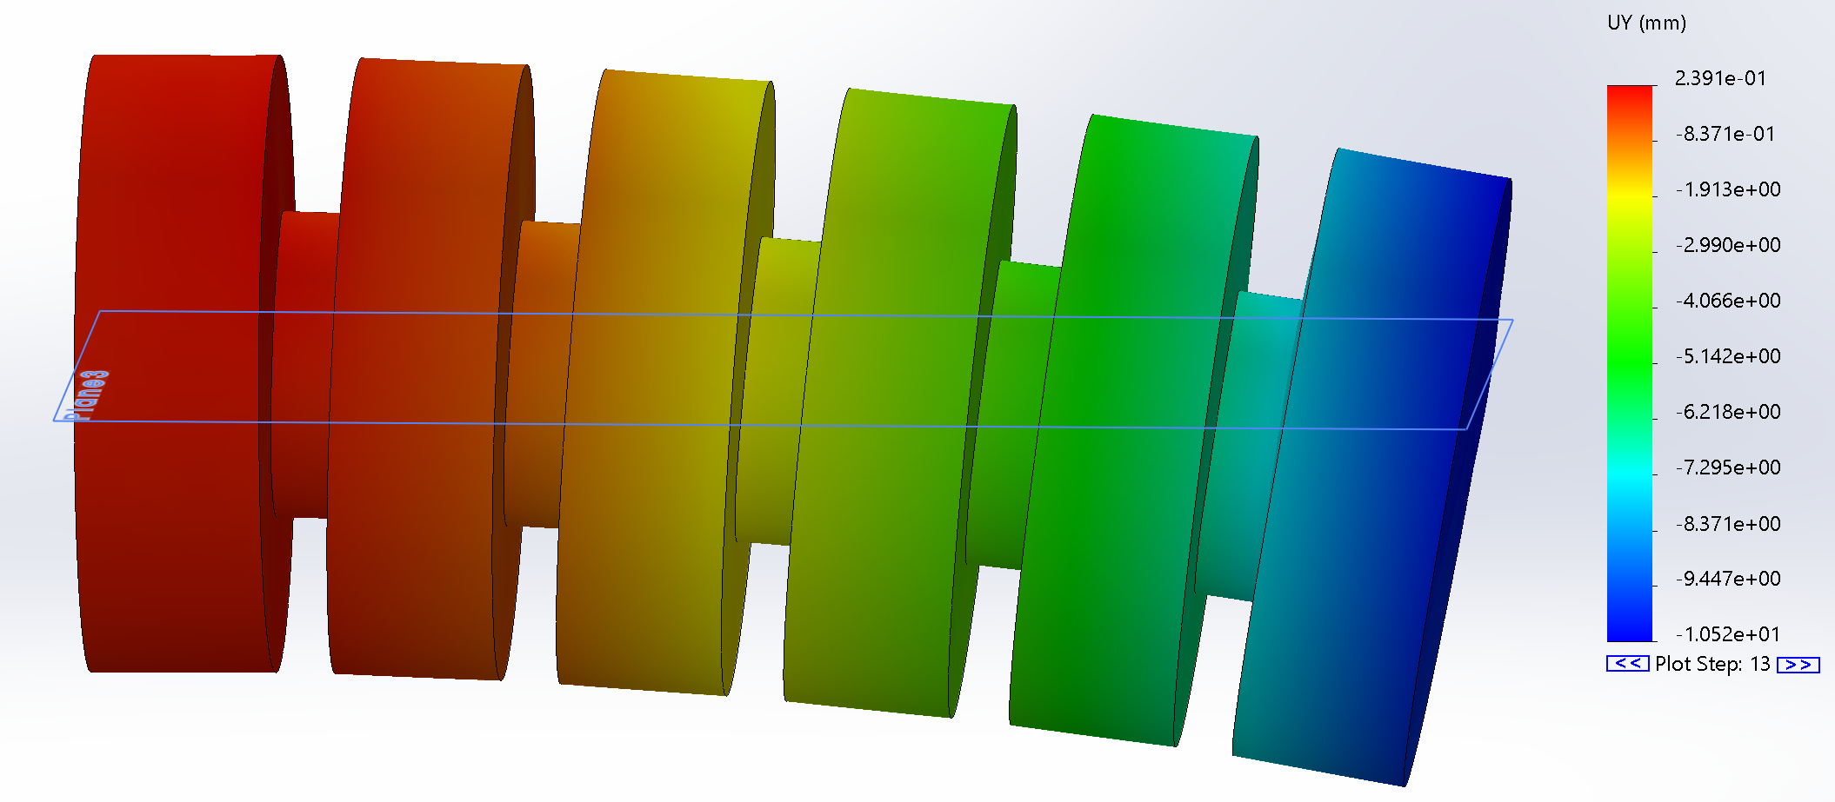
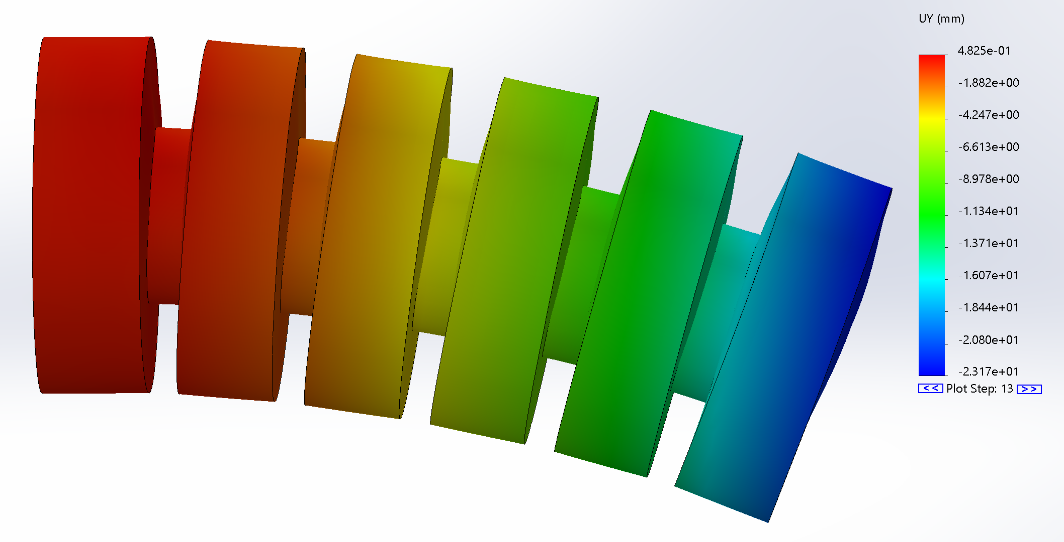
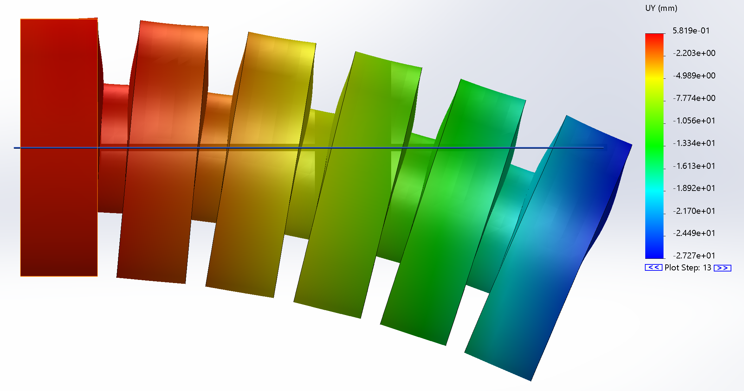
3 Chamber

Slide 3
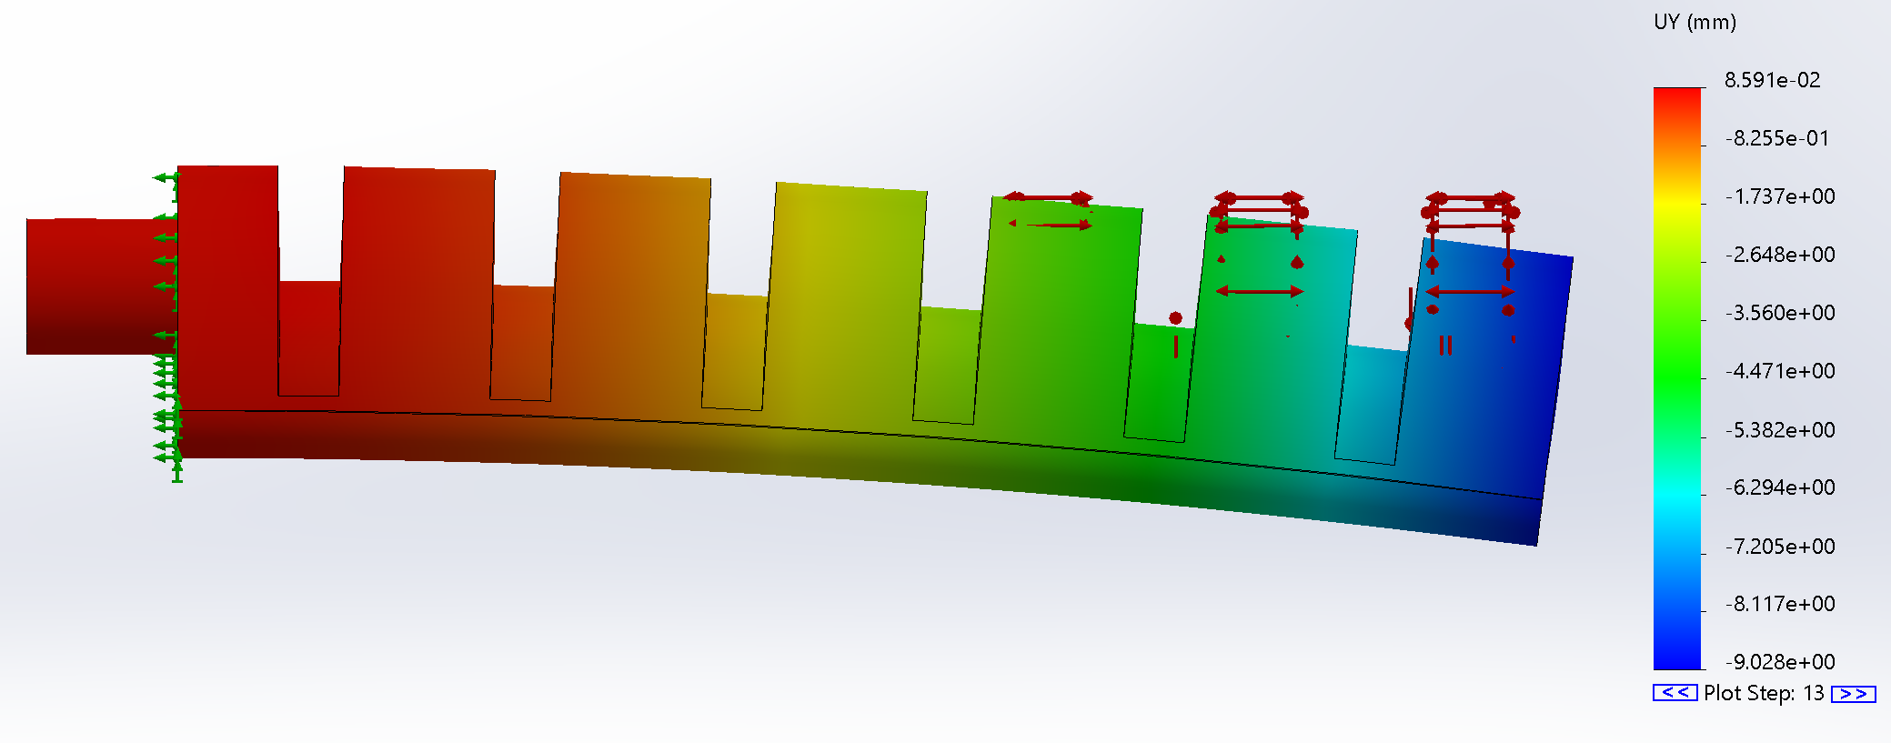
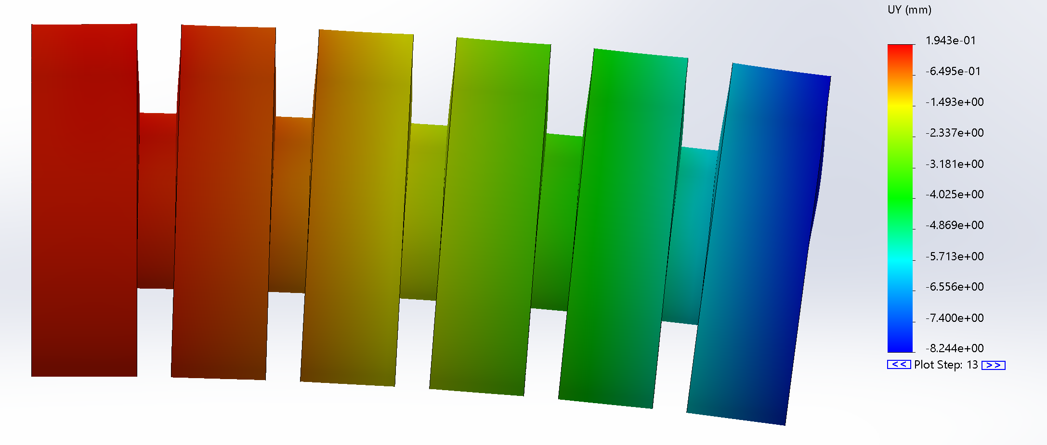
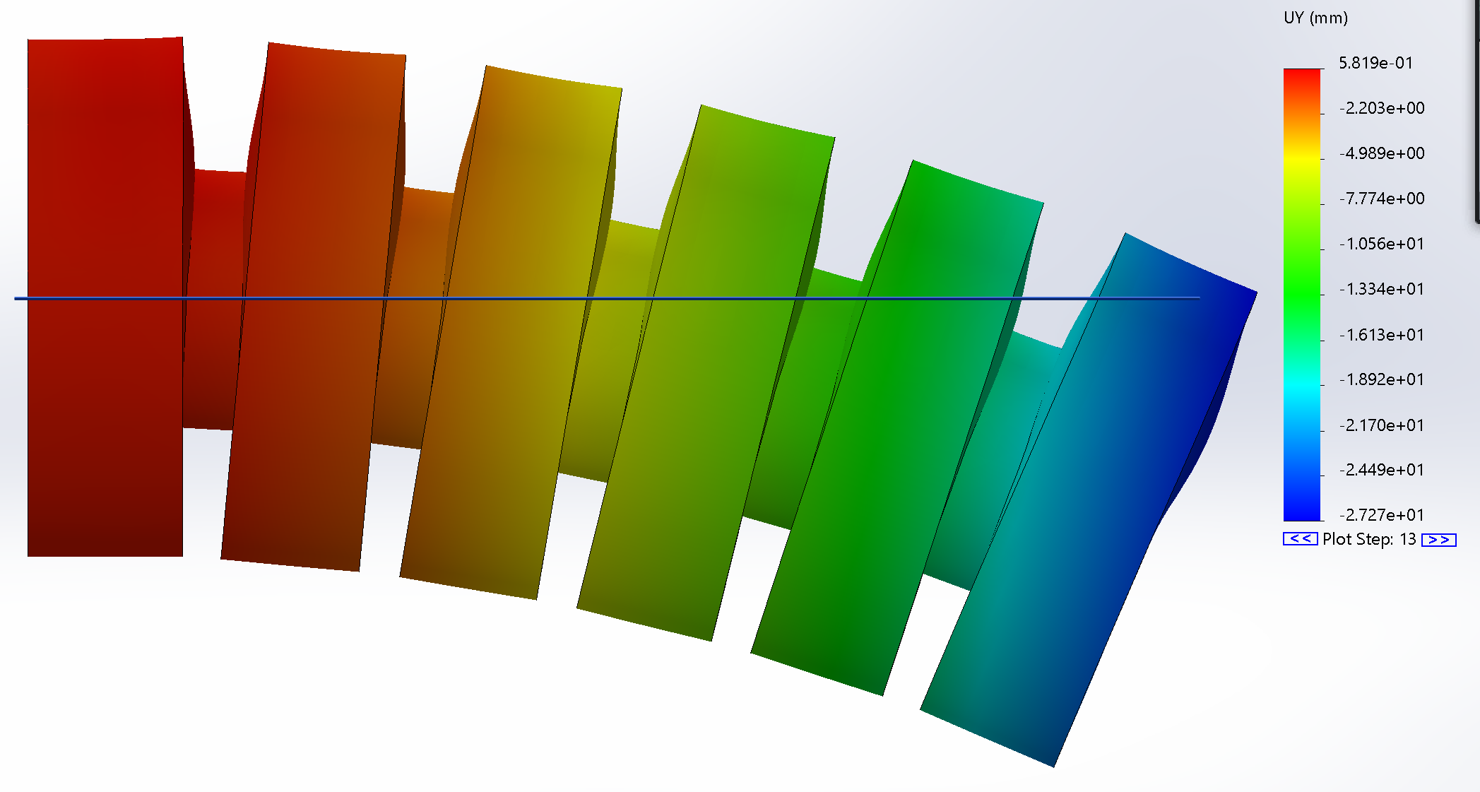
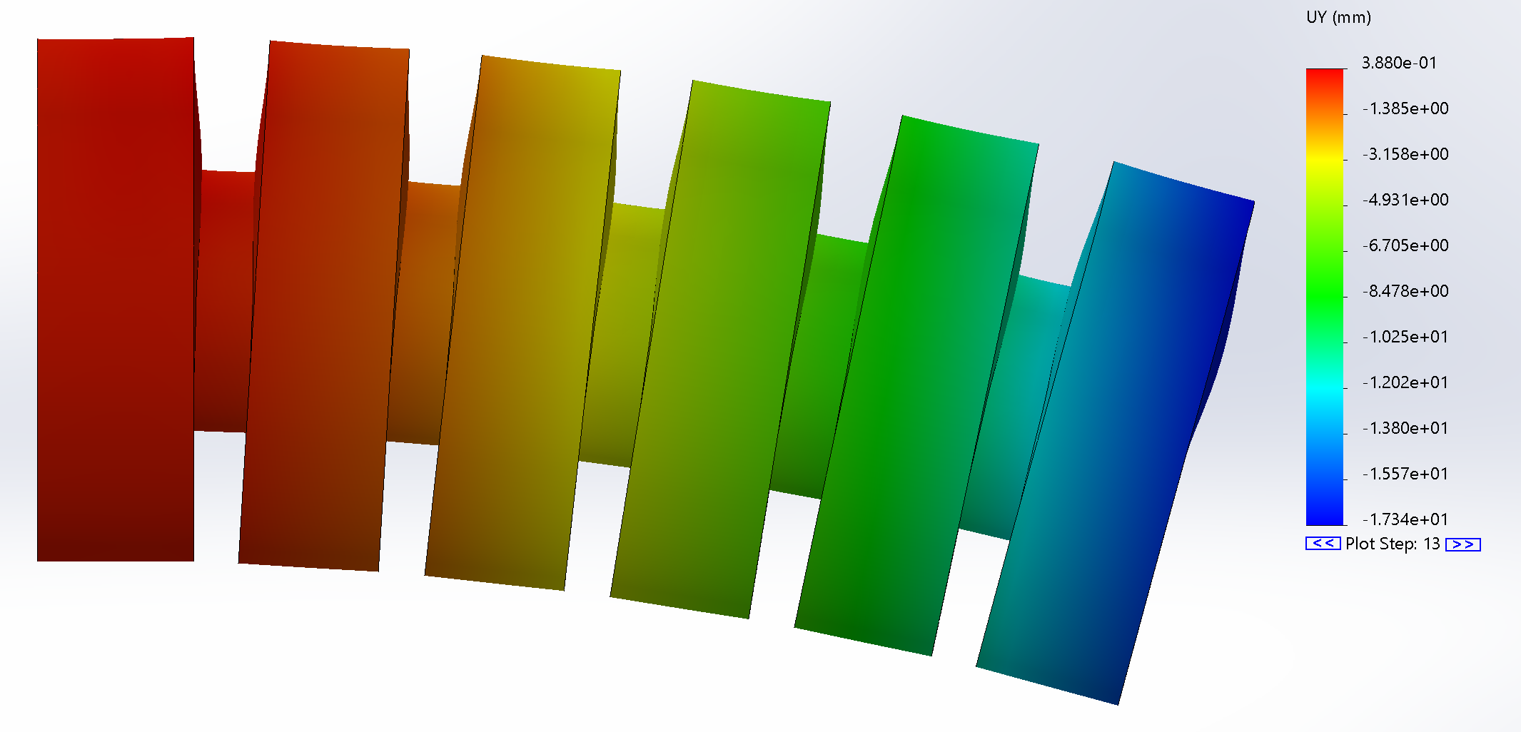
4 Chamber

Slide 4
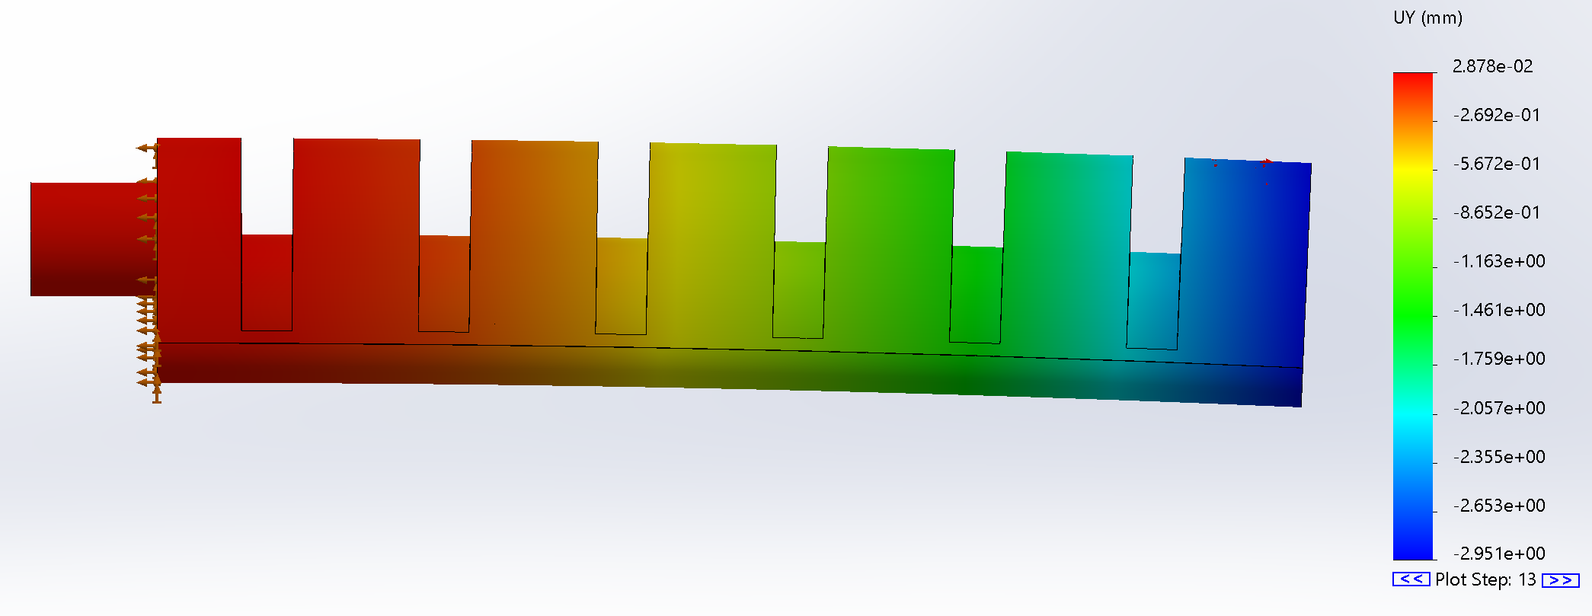
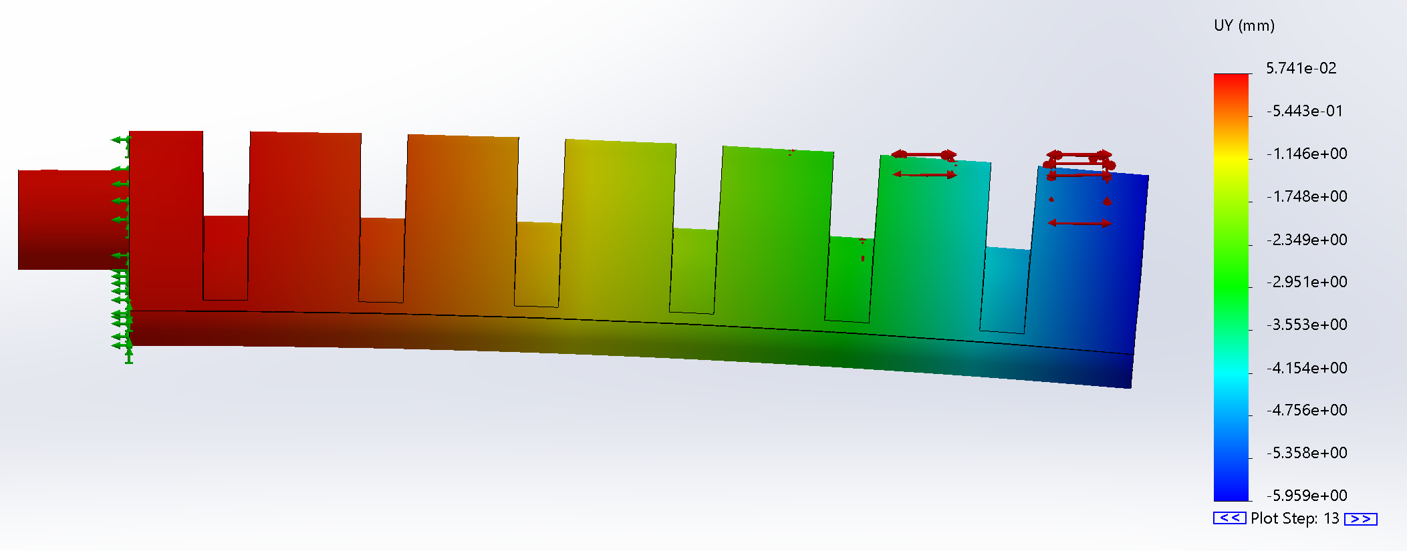
Finless Model

Slide 5
For Next Week
Reach out to jack about 272
Prove symmetry for 0 10, 10 0 for 3 and 4 chamber design
Further explore controllability of each nozzle design
0-30psi
Build Table as discussed
Build and simulate finless model to proper spec
Remind Drew to email Ally if we haven’t heard from her
Work on square helix design

